Slide 1
Chapter 7: Normalization

Slide 2
Overview of Normalization

Slide 3
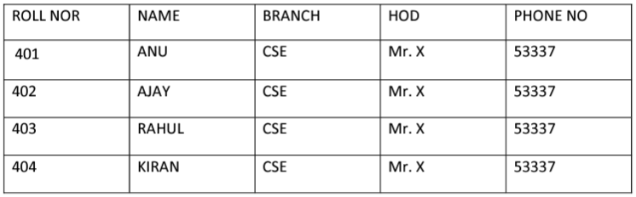
Problems Without Normalization (Example 1)
If a table is not properly normalized and have data redundancy then it will not only eat up extra memory space but will also make it difficult to handle and update the database, without facing data loss. Insertion, Updation and Deletion Anomalies are very frequent if database is not normalized. To understand these anomalies let us take an example of a Student table.
In the table above, we have data of 4 Computer Sci. students. As we can see, data for the fields branch, hod(Head of Department) and office_tel is repeated for the students who are in the same branch in the college, this is Data Redundancy.

Slide 4
Example 1
Insertion Anomaly Suppose for a new admission, until and unless a student opts for a branch, data of the student cannot be inserted, or else we will have to set the branch information as NULL. Also, if we have to insert data of 100 students of same branch, then the branch & other information will be repeated for all those 100 students. These scenarios are nothing but Insertion anomalies.
Updation Anomaly What if Mr. X leaves the college? or is no longer the HOD of computer science department? In that case all the student records will have to be updated, and if by mistake we miss any record, it will lead to data inconsistency. This is Updation anomaly.
Deletion Anomaly In our Student table, two different informations are kept together, Student information and Branch information. Hence, at the end of the academic year, if student records are deleted, we will also lose the branch information. This is Deletion anomaly.

Slide 5
Example 2
emp_id emp_name emp_address emp_dept
101 Rick Delhi D001
101 Rick Delhi D002
123 Maggie Agra D890
166 Glenn Chennai D900
166 Glenn Chennai D004
Update anomaly: In the above table we have two rows for employee Rick as he belongs to two departments of the company. If we want to update the address of Rick then we have to update the same in two rows or the data will become inconsistent. If somehow, the correct address gets updated in one department but not in other then as per the database, Rick would be having two different addresses, which is not correct and would lead to inconsistent data.

Slide 6
Example 2
Insert anomaly: Suppose a new employee joins the company, who is under training and currently not assigned to any department then we would not be able to insert the data into the table if emp_dept field doesn’t allow nulls.
Delete anomaly: Suppose, if at a point of time the company closes the department D890 then deleting the rows that are having emp_dept as D890 would also delete the information of employee Maggie since she is assigned only to this department.
To overcome these anomalies we need to normalize the data.

Slide 7
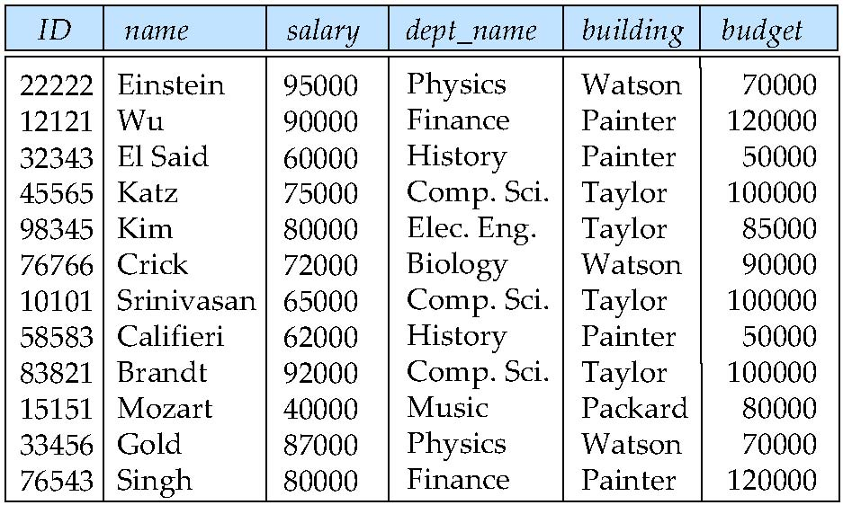
Idea of Decomposition
In Dept
There is repetition of information (i.e. deptname, building and budget)

Slide 8
Decomposition
The only way to avoid the repetition-of-information problem in the in_dep schema is to decompose it into two schemas – instructor and department schemas.
Not all decompositions are good. Suppose we decompose
employee(ID, name, street, city, salary)
into
employee1 (ID, name)
employee2 (name, street, city, salary)
The problem arises when we have two employees with the same name
The next slide shows how we lose information -- we cannot reconstruct the original employee relation -- and so, this is a lossy decomposition.

Slide 9
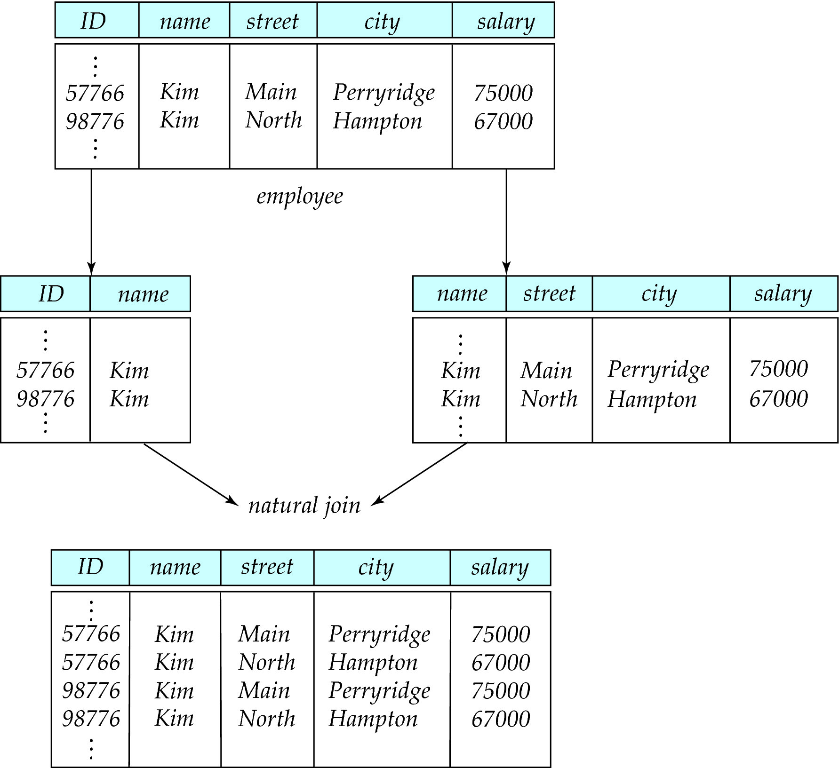
A Lossy Decomposition

Slide 10
Lossless Decomposition
Let R be a relation schema and let R₁ and R₂ form a decomposition of R . That is R = R₁ U R₂
We say that the decomposition is a lossless decomposition if there is no loss of information by replacing R with the two relation schemas R₁ U R₂
Formally,
∏ _{R1} (r) ∏ _{R2} (r) = r
And, conversely a decomposition is lossy if
  r ⊂ ∏ _{R1} (r) ∏ _{R2} (r) = r

Slide 11
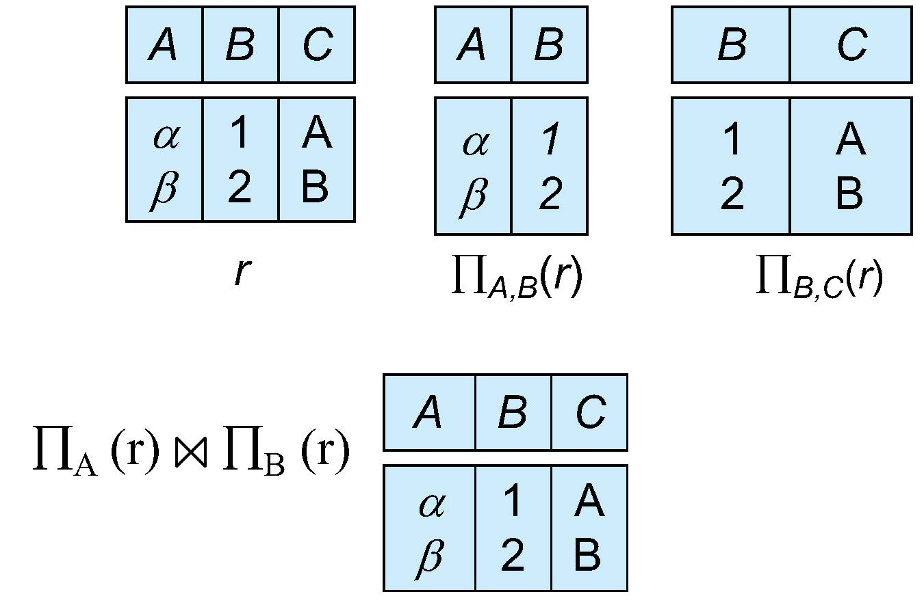
Example of Lossless Decomposition
Decomposition of R = (A, B, C)
R₁ = (A, B) R₂ = (B, C)

Slide 12
Normalization
Normalization is a database design technique that reduces data redundancy and eliminates undesirable characteristics like Insertion, Update and Deletion Anomalies. Normalization rules divides larger tables into smaller tables and links them using relationships. The purpose of Normalization is to eliminate redundant (repetitive) data and ensure data is stored logically.
If a database design is not perfect, it may contain anomalies, which are like a bad dream for any database administrator. Managing a database with anomalies is next to impossible.
It is Defined as a step-by-step process of decomposing a complex relation into a simple and stable data structure.
It is a formal process that can be followed to achieve a good database design
Also used to check that an existing design is of good quality
The different stages of normalization are known as “Normal Forms”
To accomplish normalization we need to understand the concept of Functional Dependencies.

Slide 13
What are Anomalies
Update anomalies − If data items are scattered and are not linked to each other properly, then it could lead to strange situations. For example, when we try to update one data item having its copies scattered over several places, a few instances get updated properly while a few others are left with old values. Such instances leave the database in an inconsistent state.
Deletion anomalies − We tried to delete a record, but parts of it was left undeleted because of unawareness, the data is also saved somewhere else.
Insert anomalies − We tried to insert data in a record that does not exist at all.
Normalization is a method to remove all these anomalies and bring the database to a consistent state.
Data redundancy is a condition created within a database or data storage technology in which the same piece of data is held in two separate places.

Slide 14
Functional Dependencies Definition
Let R be a relation schema
α ⊆ R and β ⊆ R
The functional dependency
α (determinant) → β (dependent)
holds on R if and only if for any legal relations r(R), whenever any two tuples t₁ and t₂ of r agree on the attributes α, they also agree on the attributes β. That is,
t₁[α] = t₂ [α] ⇒ t₁[β ] = t₂ [β ]
Example: Consider r(A,B ) with the following instance of r.
              α β
On this instance, B → A hold; A → B does NOT hold,
4
1 5
3 7

Slide 15
Functional Dependencies
Example1:
X Y
1 1
2 1
3 2
4 3
2 5
Given a set F set of functional dependencies, there are certain other functional dependencies that are logically implied by F.
  If A → B and B → C, then we can infer that A → C
  etc.
The set of all functional dependencies logically implied by F is the closure of F.
We denote the closure of F by F⁺.
Example2:
X Y
1 1
2 1
3 2
4 3
2 1
Example3: RollNo->Name for single class Otherwise no

Slide 16
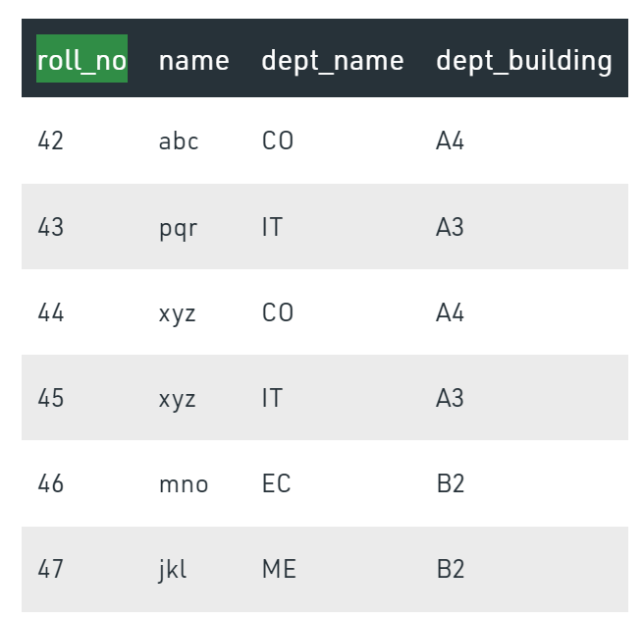
Functional Dependencies

Slide 17
Functional Dependencies
Consider the following Relation
REPORT (STUDENT#,COURSE#, StudentName,CourseName, Marks, Grade)
Description of the Attributes:
STUDENT# - Student Number
COURSE# - Course Number
StudentName- Student Name
CourseName - Course Name
Marks - Scored in Course COURSE# by Student STUDENT#
Grade - obtained by Student STUDENT# in Course COURSE#

Slide 18
Functional Dependencies- From the previous example
For each value of (Student# ,Course#), Marks obtained will be exactly one value. So we observe the following Functional dependency
STUDENT# COURSE# → Marks
For each value of Course# the name of the course will be exactly one value. So we observe the following Functional dependency
COURSE# → CourseName,
For each value of Marks the grade will be exactly one value. So we observe the following functional dependency
Marks → Grade

Slide 19
Use of Functional Dependencies
Functional Dependency avoids data redundancy. Therefore same data do not repeat at multiple locations in that database
It helps you to maintain the quality of data in the database
It helps you to defined meanings and constraints of databases
It helps you to identify bad designs
It helps you to find the facts regarding the database design

Slide 20
Armstrong’s axioms/properties of functional dependencies:
Reflexivity: If Y is a subset of X, then X→Y holds by reflexivity rule
i.e., X → X name is valid.
Augmentation: If X → Y is a valid dependency, then XZ → YZ is also valid by the augmentation rule.
i.e., If {roll_no} → name is valid, hence {roll_no, marks} → {name, marks} is also valid.
Transitivity: If X → Y and Y → Z are both valid dependencies, then X→Z is also valid by the Transitivity rule.
i.e., roll_no → dept_name & dept_name → dept_building, then roll_no → dept_building is also valid.
Union: If X → Y and X → Z are both valid dependencies, then X→YZ is also valid by the Union rule. i.e. IF rollno →name, rollno →marks, then rollno → name, marks
Decomposition/Splitting: If X →YZ is valid dependency, then X→Y & X → Y & X → Z are also valid by the Union rule.
Psuedo Transitivity: If X →Y & YZ →A, then XZ →A
i.e., rollno →name & name, marks →grade then ?

Slide 21
Types of Functional dependencies in DBMS:
Trivial functional dependency
Non-Trivial functional dependency
Multivalued functional dependency
Transitive functional dependency

Slide 22
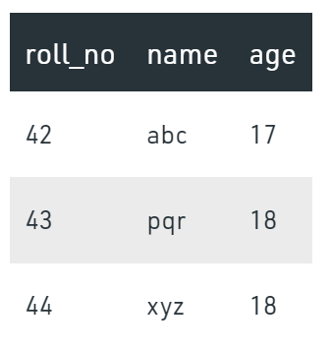
Trivial Functional Dependencies
A functional dependency is trivial if it is satisfied by all instances of a relation
In Trivial Functional Dependency, a dependent is always a subset of the determinant.
i.e. If X → Y and Y is the subset of X (i.e. α → β is trivial if β ⊆ α ), then it is called trivial functional dependency
Example:
  ID, name → ID
  name → name
Here, {roll_no, name} → name is a trivial functional dependency, since the dependent name is a subset of determinant set {roll_no, name}
Similarly, roll_no → roll_no is also an example of trivial functional dependency.

Slide 23
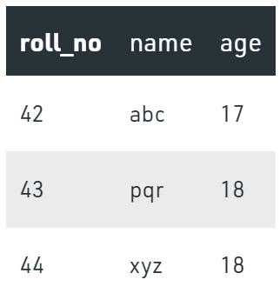
Non Trivial Functional Dependency
In Non-trivial functional dependency, the dependent is strictly not a subset of the determinant.
i.e. If X → Y and Y is not a subset of X, then it is called Non-trivial functional dependency.
Here, roll_no → name is a non-trivial functional dependency, since the dependent name is not a subset of determinant roll_no
Similarly, {roll_no, name} → age is also a non-trivial functional dependency, since age is not a subset of {roll_no, name}

Slide 24
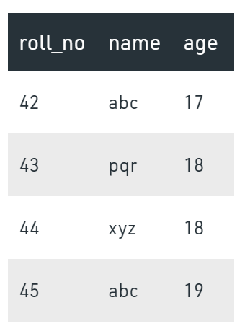
Multivalued Functional Dependency
In Multivalued functional dependency, entities of the dependent set are not dependent on each other.
i.e. If a → {b, c} and there exists no functional dependency between b and c, then it is called a multivalued functional dependency.
Here, roll_no → {name, age} is a multivalued functional dependency, since the dependents name & age are not dependent on each other(i.e. name → age or age → name doesn’t exist !)

Slide 25
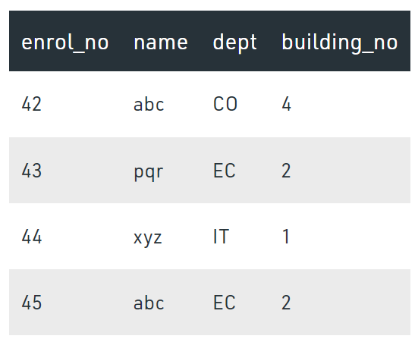
Transitive Functional Dependency
In transitive functional dependency, dependent is indirectly dependent on determinant.
i.e. If a → b & b → c, then according to axiom of transitivity, a → c. This is a transitive functional dependency
Here, enrol_no → dept and dept → building_no,
Hence, according to the axiom of transitivity, enrol_no → building_no is a valid functional dependency. This is an indirect functional dependency, hence called Transitive functional dependency.

Slide 26
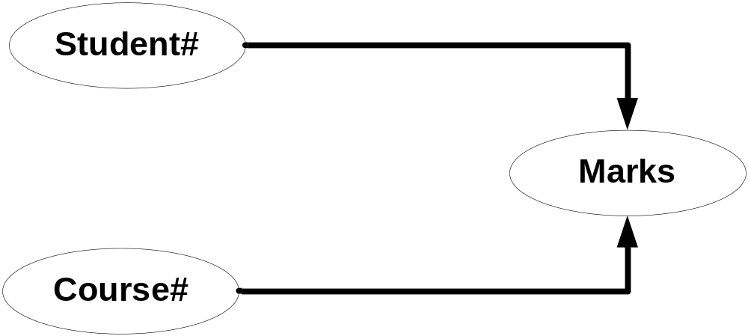
Full dependencies
X and Y are attributes.
X Functionally determines Y
Note: Subset of X should not functionally determine Y
Notes:
In above example Marks is fully functionally dependent on STUDENT# COURSE# and not on sub set of STUDENT# COURSE#. This means Marks can not be determined either by STUDENT# OR COURSE# alone. It can be determined only using STUDENT# AND COURSE# together. Hence Marks is fully functionally dependent on STUDENT# COURSE#.

Slide 27
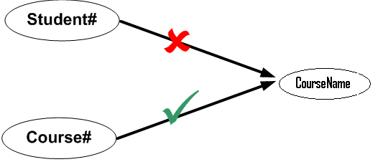
Partial dependencies
X and Y are attributes.
Attribute Y is partially dependent on the attribute X only if it is dependent on a sub-set of attribute X.
We have both the functional dependency valid in our example
Student# Course# CourseName
Course# CourseName
So we can say that CourseName is partially dependent on Student# Course#
Notes:
CourseName is not fully functionally dependent on STUDENT# COURSE# because subset of STUDENT# COURSE# i.e only COURSE# determines the CourseName and STUDENT# does not have any role in deciding CourseName. Hence CourseName is not fully functionally dependent on STUDENT# COURSE#.
In the above relationship CourseName is partially dependent on composite attributes STUDENT# COURSE# because COURSE# alone defines the CourseName.

Slide 28
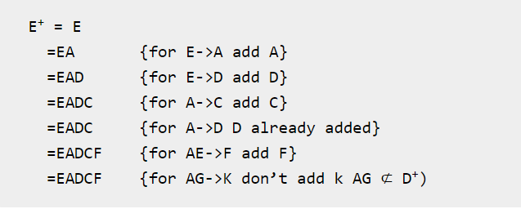
Attribute Closure
Closure of an attribute x is the set of all attributes that are functional dependencies on X with respect to F. It is denoted by X+ which means what X can determine.
Q. Consider a relation R(A,B,C,D,E,F) where F: E->A, E->D, A->C, A->D, AE->F, AG->K. Find the closure of E or E⁺
Let the relation R(A,B,C,D,E,F) where F: B->C, BC->AD, D->E, CF->B. Find the closure of B.
  B⁺ = {B,C,A,D,E}

Slide 29
Attribute Closure
Q. R(A,B,C,D,E) AND F: A->B,B->C, C->D, A->E. Find the closure of F
  A⁺= {A,B,C,D,E}
  B⁺= {B,C,D}
  C⁺= {C,D}
  F⁺= {A->A, A->B, A->C, A->D, A->E, B->B, B->C, B->D, C->C, C->D}

Slide 30
Attribute Closure
Q. Consider a relation R ( A , B , C , D , E , F , G ) with the functional dependencies-
A → BC
BC → DE
D → F
CF → G
Now, let us find the closure of some attributes and attribute sets-
Solution:
A⁺ = { A }
= { A , B , C } ( Using A → BC )
= { A , B , C , D , E } ( Using BC → DE )
= { A , B , C , D , E , F } ( Using D → F )
= { A , B , C , D , E , F , G } ( Using CF → G )
Thus,
A⁺ = { A , B , C , D , E , F , G }
D⁺ = { D , F }, { B , C }⁺ = { B , C , D , E , F , G }

Slide 31
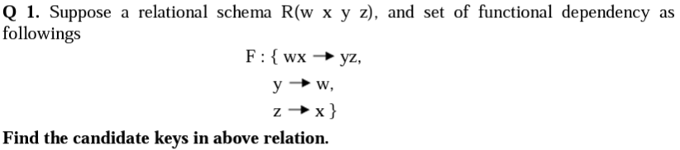
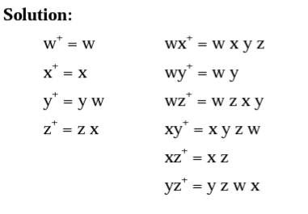
Candidate Keys and Super Keys
Candidate Key: is a minimal set of attributes of a relation which can be used to identify a tuple uniquely.
Super Key: is a set of attributes of a relation which can be used to identify a tuple uniquely.
A candidate key is always a super key but not vice versa.
The set of attributes whose attribute closure is set of all attributes of relation is called super key of relation and if this is minimal is called candidate key.
Therefore wx, wz, xy, yz are the candidate keys in this relation because the closure of these have all the attributes of relation.

Slide 32
Candidate Keys and Super Keys
Q. R(A,B,C,D,E,F) WHERE F:A->BC, B->D, C->DE, BC->F. Then, find the candidate keys of R.
Solution:
  A⁺= {A,B,C,D,E,F}={R}=>A is a candidate key
  B⁺= {B,D} => B is not a candidate key
  C⁺= {C,D,E} => C is not a candidate key
  BC⁺= {B,C,D,E,F} => BC is not a candidate key
  Closure of F (F+): F+ is the set of all FDs that can be inferred/ derived from F. Using Armstrong Axioms repeatedly on F, we can compute all the FDs.

Slide 33
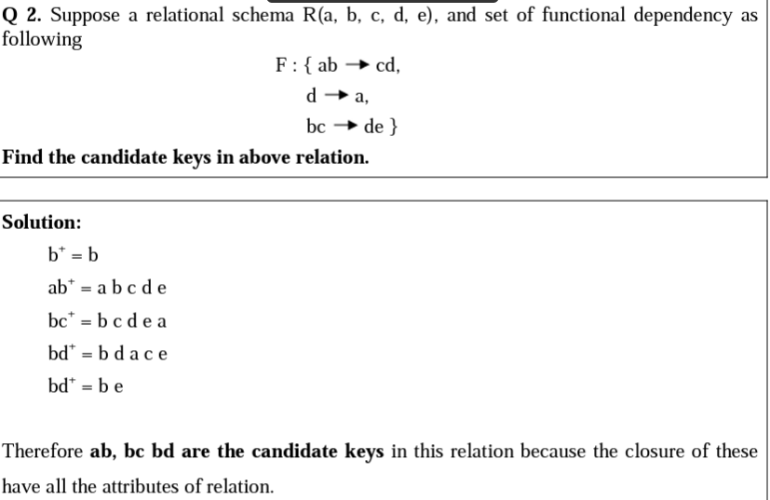
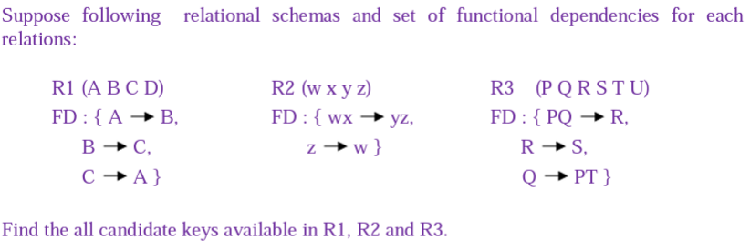

Slide 34
Q. FD = {E-ID->E-NAME, E-ID->E-CITY, E-ID->E-STATE, E-CITY->E-STATE}
  (E-ID)+ = {E-ID, E-NAME,E-CITY,E-STATE}
  (E-ID,E-NAME)+ = {E-ID, E-NAME,E-CITY,E-STATE}
  (E-ID,E-CITY)+ = {E-ID, E-NAME,E-CITY,E-STATE}
  (E-ID,E-STATE)+ = {E-ID, E-NAME,E-CITY,E-STATE}
  (E-ID,E-CITY,E-STATE)+ = {E-ID, E-NAME,E-CITY,E-STATE}
  (E-NAME)+ = {E-NAME}
  (E-CITY)+ = {E-CITY,E-STATE}
As (E-ID)⁺, (E-ID, E-NAME)⁺, (E-ID, E-CITY)⁺, (E-ID, E-STATE)⁺, (E-ID, E-CITY, E-STATE)⁺ give set of all attributes of relation EMPLOYEE. So all of these are super keys of relation.
The minimal set of attributes whose attribute closure is set of all attributes of relation is called candidate key of relation. As shown above, (E-ID)⁺ is set of all attributes of relation and it is minimal. So E-ID will be candidate key. On the other hand (E-ID, E-NAME)⁺ also is set of all attributes but it is not minimal because its subset (E-ID)⁺ is equal to set of all attributes. So (E-ID, E-NAME) is not a candidate key.

